Slide 1


Company Name
Building a Culture of Recognition at
Deliver impact from the beginning by including your company name, logo, and objective.

Slide 2


Why Recognition?
3.0
42%
3/10
Glassdoor Rating
Average Engagement Rating, Q2
Turnover, 2022
Ensure you play to your audience and don’t overload them with figures
Need ideas on what numbers you can use? Here are great ones to present:
eNPS score
Engagement survey score ("do you feel rewarded and recognized?", “are you happy with our employee experience?”, “do feel as though we listen to feedback?”)
Turnover %
Avg Absenteeism / month
Snippets around what people are saying during exit interviews
Glassdoor rating
Competitor Glassdoor rating
Competitor HR awards (Check sources like Top 100 Employers, Forbes, Great Place to Work, The Globe & Mail, LinkedIn)
Cost to hire, recruit replace

Slide 3
Problem Summary
Our feedback surveys from employees have overwhelmingly reported feelings of low morale, low engagement, and a desire for more consistent recognition.
Instead of a Current Performance slide, you may find it more appropriate to create a Problem Summary or Industry Standards (i.e., rewards budget). Consider using slides 4 & 5, “Price of Disengagement” and “Opportunity.”

Slide 4

The Price of Disengagement
“Replacing workers requires one-half to two times the employee’s annual salary…
…so, it costs $9000 a year to keep each disengaged worker
and
between $25,000 and $100,000 to replace them.”*
*Gallup’s State of the Global Workplace: 2021 Report

Slide 5
Opportunity
“48% of working population is actively job searching or watching for opportunities”*
COMPANIES THAT PRIORITIZE PEOPLE & CULTURE ARE WINNING THE WAR FOR TALENT

Slide 6
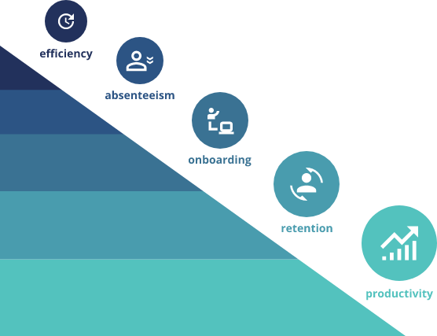
Project Impact
Communicate how much you plan to invest in employee recognition and the projected return on investment. What is the estimated reduction in turnover? How much will productivity increase? Addressing these questions will help you get buy-in from leadership. Access our ROI Calculator to expand details (not necessarily numbers) on how efficiency, absenteeism, onboarding, retention, and productivity will be affected with the proposed program.
XX%
XX%
XX%
XX%
XX%

Slide 7
Budget
Use this space to detail how much this will cost, where the money will come from, and if you’ll need additional budget. Include also when you need it.
Consider if a budget needs to be requested in a lump sum or over the course of several periods. Generally, robust programs allot 1-3% of payroll towards rewards.
 | Cost, in thousands
New, Streamlined Rewards and Recognition Program Fees & Subscription Onboarding | 3,000 50 15
Existing Rewards and Recognition Program | -(2,900)
Additional Budget Requested, $ | 165
Recurring Cost as % of Payroll (2023) | 3%

Slide 8
Next Steps
Be clear with what needs to happen next, and what to expect in future stages.
Goals
Scope
Partnership Conversations
Program Communication & Launch
Measure The Results
Consider things like: budget, awards preference, expected programs? Do you need a Milestones/Service Awards program, Peer-to-Peer Recognition? Bulk rewards?
Collaborate with the right vendor to see how they can help you reach your objectives.
Make sure all stakeholders are aware of objectives, what is expected of them, and why their participation will be beneficial for them.
Before launching, make sure you have a plan on how to measure the effectiveness of your program, then tweak things over time to see what works best for your team.
Are you hoping to improve retention? Create a more engaged workforce? Better align your team around your core values and goals?
1
2
3
4
5

Slide 9

Appendix
This section contains some additional optional statistics and data to help underline the case for recognition. Include the ones that work for you, add some of your own, and remove the ones that aren’t relevant

Slide 10
Appendix A
Why is having an employee recognition program important?
A common reason that employees leave their jobs is due to lack of recognition. Millennials want immediate rewards for recognition and companies need platforms to support their employees.
Having an employee recognition program is a great way to inspire performance, increase productivity and build an amazing company culture. Not only does employee recognition keep your current employees engaged, but it also helps you attract the best candidates and retain your top talent.
65% of employees received NO recognition for good work | 42% of employees are unaware about their “service awards” programs
31% lower turnover rates are seen in companies within the top 20% of recognition-rich culture | 14% of companies provide managers with the tools they need to create impactful cultures of recognition

Slide 11

TODAY’S EXPECTATIONS
Appendix B
Employees
Companies
Anywhere, Real-Time
Immediate Value
Transparency
Instant Fulfillment
Alignment to Values
Data for Coaching
Real-time Tax Reports
Multigenerational Appeal
Notes:
When it comes to recognition, there’s a new set of expectations….
Employees:
- Want it to happen anywhere and in real-time
- They want rewards to have real, transparent, value
- Rewards should be redeemable right away,
Companies
Want recognition to align with key behaviours and values
Need data for coaching, and tax reports
Platform needs to appeal regardless of their age and comfort with technology

Slide 12
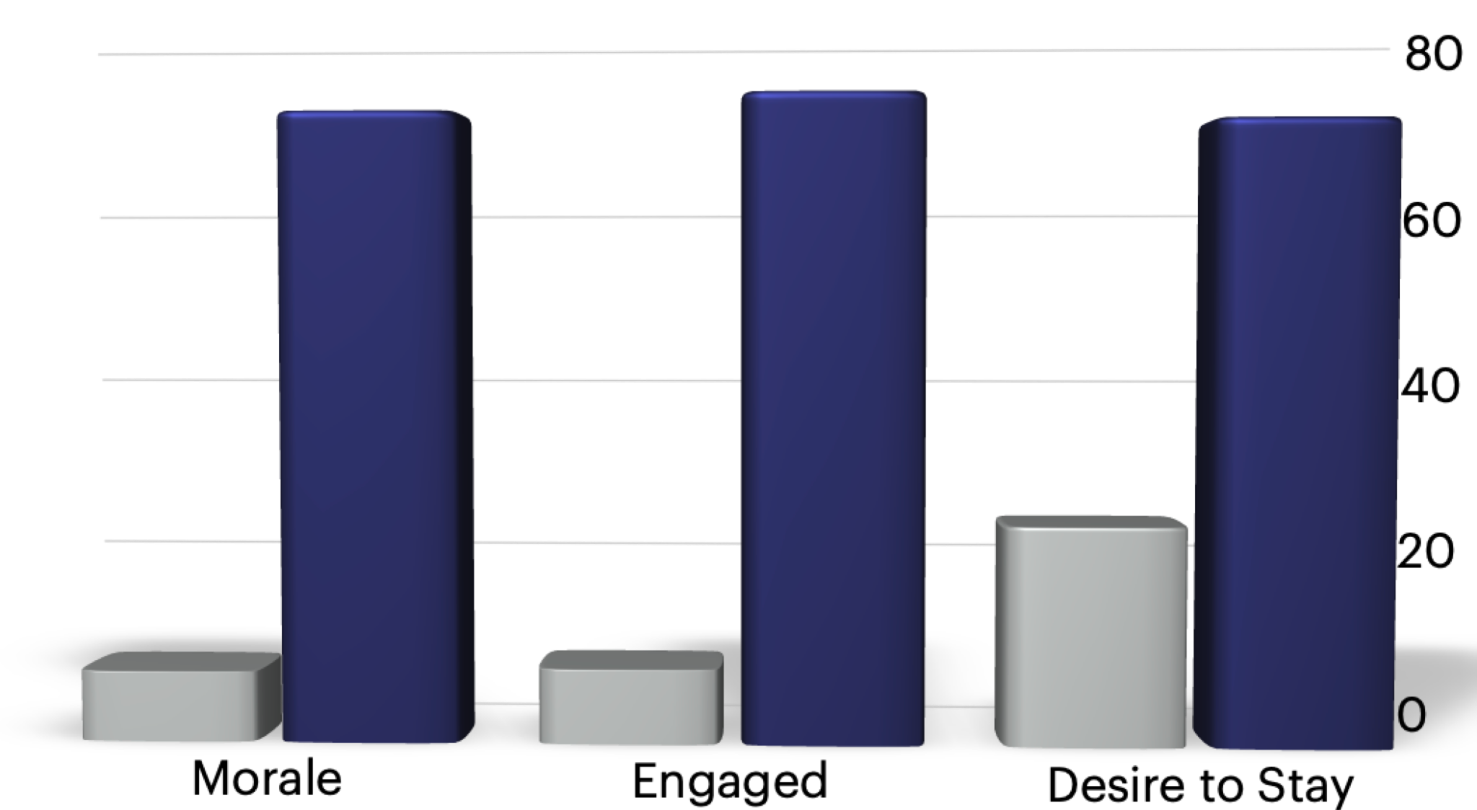
OPPORTUNITY
Appendix C
9X
8X
2.5X
*Survey of 100,000 managers

Slide 13
Appendix D
What other metrics should I include in my Appendix?
Include gains, expense funding, change mgmt., communication strategy, risks, impact analysis, sustainability and how you will review and gather feedback and measure success.

Slide 14
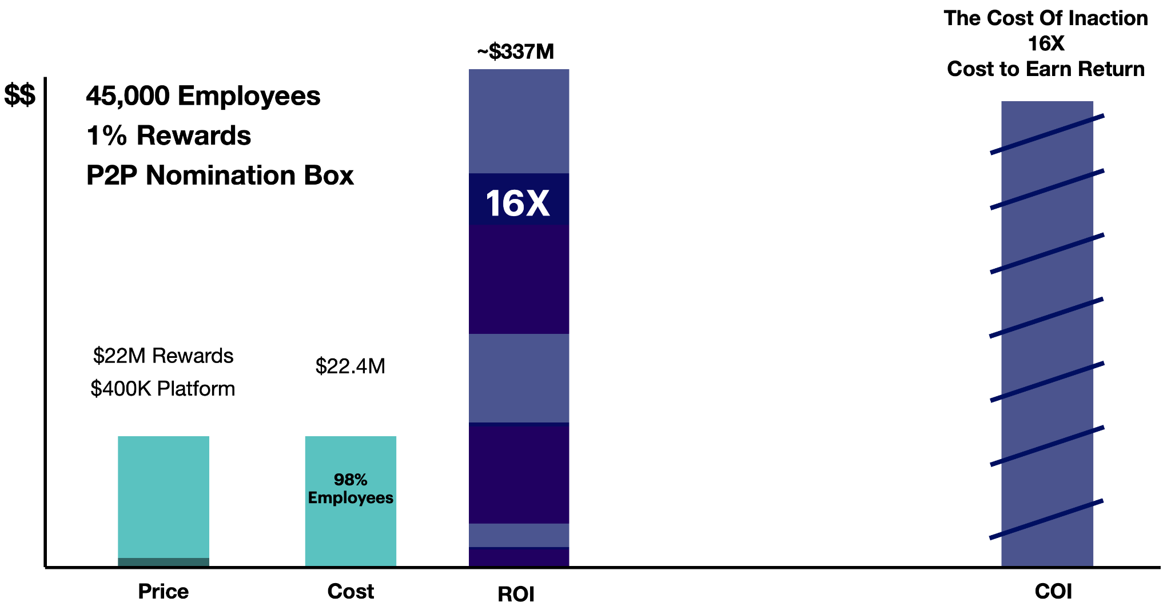
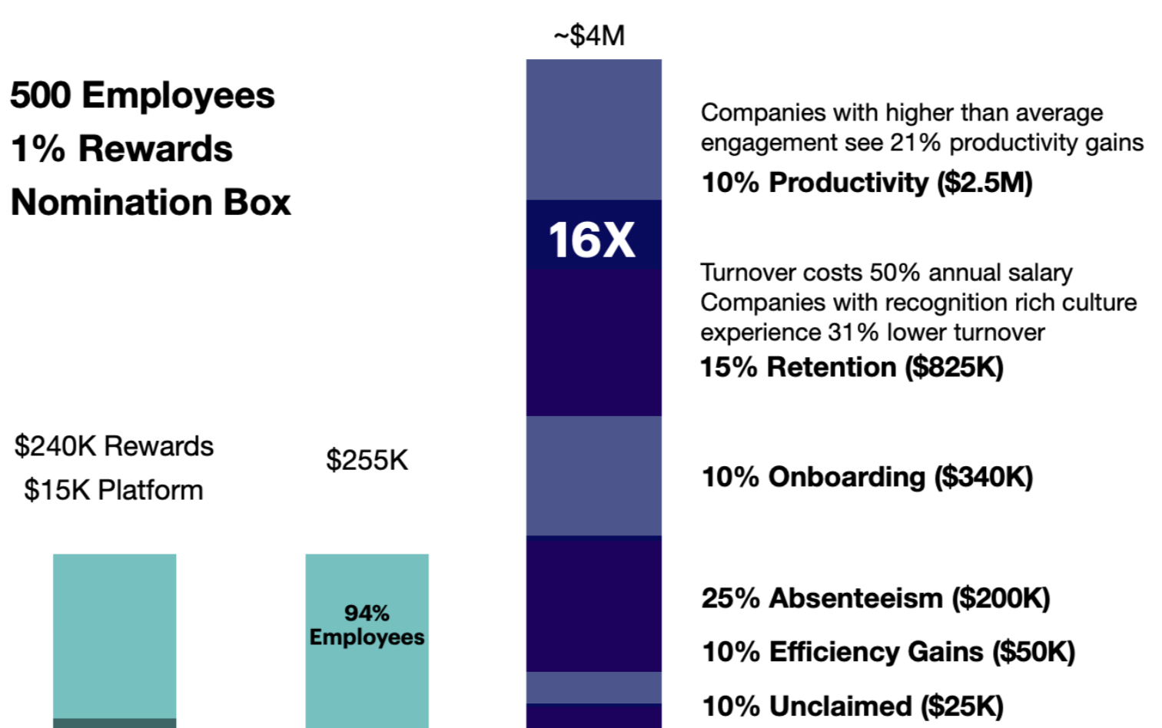
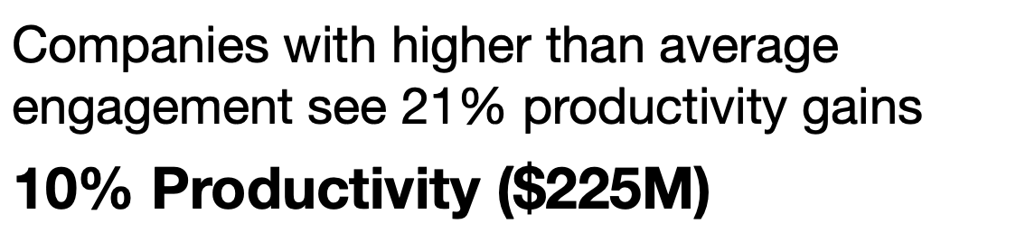
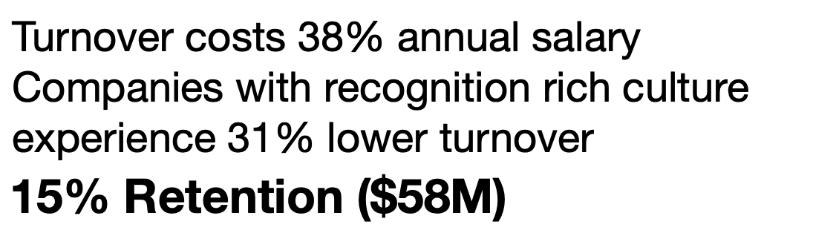
RETURN ON RECOGNITION
Appendix E
These next few slides break down how some of the ROI figures for recognition are calculated, with some examples of different program structures
500 Employees
10% Onboarding ($30M)
25% Absenteeism ($19M)
10% Efficiency Gains ($2M)
10% Unclaimed ($2M)
Notes:
Productivity
Research shows that companies with higher than average employee engagement levels benefit from 21% higher productivity.
For the purpose of incorporating different scenarios, let’s be conservative and estimate that an effective employee recognition program can lead to 10% higher productivity (i.e. your people could produce just 10% more, saving you from having to hire 10% more people to complete a job).
Total Productivity Gain = # of Employees x Salary x Productivity Increase
Total Productivity Gain = 45,000 x $50,000 x 10%
Total Productivity Gain = $225M
Retention
High employee turnover is one of the largest costs to employers. It includes the cost of re-hiring, training, ramp-up periods, loss of expertise, and higher workloads for other employees while that position is vacant. Voluntary turnover is often due to a disengaged workforce, and in search of jobs that offer better pay, more challenging work, and with a better culture of recognition.
The Bureau of Labor Statistics reports an average turnover rate of 44% annually in the US, as well as an average turnover costs at 38% of the annual salary. This includes hiring, training, ramp-up, loss of expertise during time, higher workloads for other employees while position is vacant.
Besin by Deloitte research found that companies that scored in the top 20% for building a “recognition-rich culture” had 31% lower turnover rates.
Turnover Savings = (45,000 x 44%) x ($50,000 x 38%) x 31%
Turnover Savings @ 31% = $116,622,000
Turnover Savings @ 15% = $58,311,000
On-boarding new hires is a time consuming and expensive process. According to a survey by Korn Ferry, 74% of executives believe that on-boarding is a key factor in retaining new hires. The survey also showed that 67% of the executives believed that including mentors in on-boarding help new hires acclimate better, but half these companies did not have any mentorship programs in place. Having a mentor during on-boarding saves training time as well as improves new hire transition - this depends on commitments from older, highly engaged employees to create a welcoming environment.
On-boarding cost is the cost of lost productivity in a 60 working day on-boarding period, out of a 240 working day year. We estimate an engaged workforce can speed up on-boarding by 10%.
The number of on-boarded employees include new employees through business growth (assumed to be 10% here) as well as from turnover (at 44%).
On-boarding Savings = On-boarding Cost x Savings % x # of On-Boarded Employees
On-boarding Savings = (Training Period x Salary) Savings % x # Employees x (Growth + Turnover)
On-boarding Savings = (60/240 x $50,000) x 10% x 24,300 (10% Growth + 44% Turnover)
On-boarding Savings = $30,375M+
Absenteeism
Companies who move engagement scores from below average to above average can see a 50% reduction in absenteeism
Studies show that on average employees are absent 8 days per year. A 25% reduction would be 2 days per year, per employee.
$50,000/240 working days = $208/day
2 days x 2 = $416
$416 x 45,000 = $18.75M
Efficiency Gains
On average, you need to hire 1-2ppl for every thousand employees, to properly manage a recognition program in-house. Brookdale would need to hire 45-90 people.
45 x $50,000 = $2,250,000
Unclaimed
10% of $22M in rewards is $2.2M

Slide 15
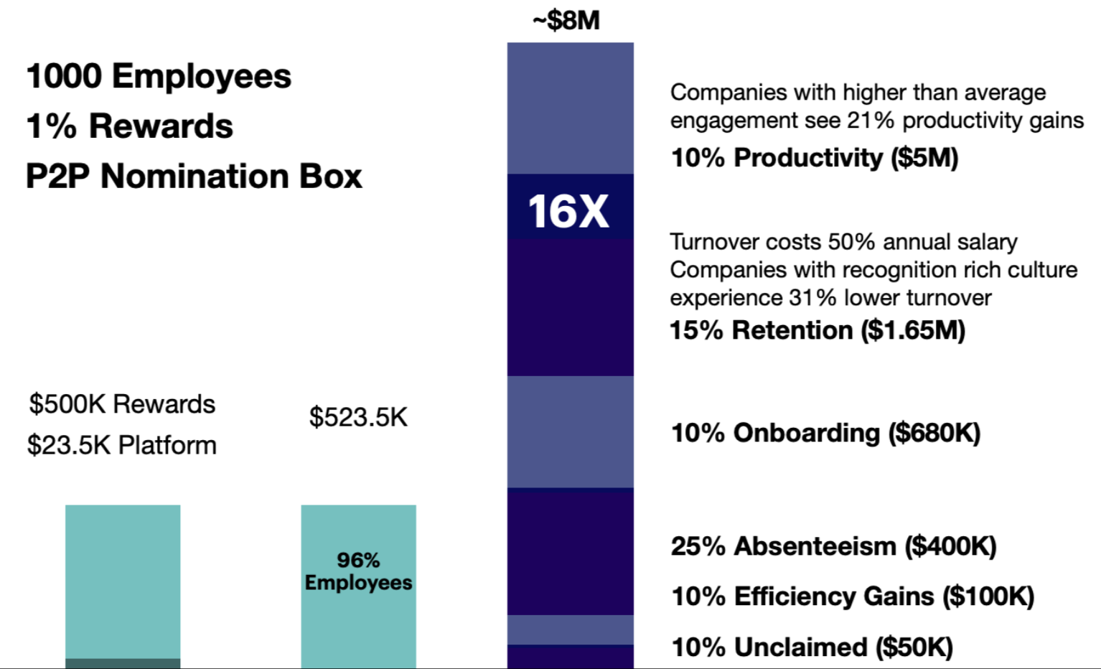
RETURN ON RECOGNITION
Appendix E
1000 Employees
10% Onboarding ($30M)
25% Absenteeism ($19M)
10% Efficiency Gains ($2M)
10% Unclaimed ($2M)
Notes:
Productivity
Research shows that companies with higher than average employee engagement levels benefit from 21% higher productivity.
For the purpose of incorporating different scenarios, let’s be conservative and estimate that an effective employee recognition program can lead to 10% higher productivity (i.e. your people could produce just 10% more, saving you from having to hire 10% more people to complete a job).
Total Productivity Gain = # of Employees x Salary x Productivity Increase
Total Productivity Gain = 45,000 x $50,000 x 10%
Total Productivity Gain = $225M
Retention
High employee turnover is one of the largest costs to employers. It includes the cost of re-hiring, training, ramp-up periods, loss of expertise, and higher workloads for other employees while that position is vacant. Voluntary turnover is often due to a disengaged workforce, and in search of jobs that offer better pay, more challenging work, and with a better culture of recognition.
The Bureau of Labor Statistics reports an average turnover rate of 44% annually in the US, as well as an average turnover costs at 38% of the annual salary. This includes hiring, training, ramp-up, loss of expertise during time, higher workloads for other employees while position is vacant.
Besin by Deloitte research found that companies that scored in the top 20% for building a “recognition-rich culture” had 31% lower turnover rates.
Turnover Savings = (45,000 x 44%) x ($50,000 x 38%) x 31%
Turnover Savings @ 31% = $116,622,000
Turnover Savings @ 15% = $58,311,000
On-boarding new hires is a time consuming and expensive process. According to a survey by Korn Ferry, 74% of executives believe that on-boarding is a key factor in retaining new hires. The survey also showed that 67% of the executives believed that including mentors in on-boarding help new hires acclimate better, but half these companies did not have any mentorship programs in place. Having a mentor during on-boarding saves training time as well as improves new hire transition - this depends on commitments from older, highly engaged employees to create a welcoming environment.
On-boarding cost is the cost of lost productivity in a 60 working day on-boarding period, out of a 240 working day year. We estimate an engaged workforce can speed up on-boarding by 10%.
The number of on-boarded employees include new employees through business growth (assumed to be 10% here) as well as from turnover (at 44%).
On-boarding Savings = On-boarding Cost x Savings % x # of On-Boarded Employees
On-boarding Savings = (Training Period x Salary) Savings % x # Employees x (Growth + Turnover)
On-boarding Savings = (60/240 x $50,000) x 10% x 24,300 (10% Growth + 44% Turnover)
On-boarding Savings = $30,375M+
Absenteeism
Companies who move engagement scores from below average to above average can see a 50% reduction in absenteeism
Studies show that on average employees are absent 8 days per year. A 25% reduction would be 2 days per year, per employee.
$50,000/240 working days = $208/day
2 days x 2 = $416
$416 x 45,000 = $18.75M
Efficiency Gains
On average, you need to hire 1-2ppl for every thousand employees, to properly manage a recognition program in-house. Brookdale would need to hire 45-90 people.
45 x $50,000 = $2,250,000
Unclaimed
10% of $22M in rewards is $2.2M

Slide 16

RETURN ON RECOGNITION
Appendix E
10,000 Employees
1000 Employees
10% Onboarding ($30M)
25% Absenteeism ($19M)
10% Efficiency Gains ($2M)
10% Unclaimed ($2M)
Notes:
Productivity
Research shows that companies with higher than average employee engagement levels benefit from 21% higher productivity.
For the purpose of incorporating different scenarios, let’s be conservative and estimate that an effective employee recognition program can lead to 10% higher productivity (i.e. your people could produce just 10% more, saving you from having to hire 10% more people to complete a job).
Total Productivity Gain = # of Employees x Salary x Productivity Increase
Total Productivity Gain = 45,000 x $50,000 x 10%
Total Productivity Gain = $225M
Retention
High employee turnover is one of the largest costs to employers. It includes the cost of re-hiring, training, ramp-up periods, loss of expertise, and higher workloads for other employees while that position is vacant. Voluntary turnover is often due to a disengaged workforce, and in search of jobs that offer better pay, more challenging work, and with a better culture of recognition.
The Bureau of Labor Statistics reports an average turnover rate of 44% annually in the US, as well as an average turnover costs at 38% of the annual salary. This includes hiring, training, ramp-up, loss of expertise during time, higher workloads for other employees while position is vacant.
Besin by Deloitte research found that companies that scored in the top 20% for building a “recognition-rich culture” had 31% lower turnover rates.
Turnover Savings = (45,000 x 44%) x ($50,000 x 38%) x 31%
Turnover Savings @ 31% = $116,622,000
Turnover Savings @ 15% = $58,311,000
On-boarding new hires is a time consuming and expensive process. According to a survey by Korn Ferry, 74% of executives believe that on-boarding is a key factor in retaining new hires. The survey also showed that 67% of the executives believed that including mentors in on-boarding help new hires acclimate better, but half these companies did not have any mentorship programs in place. Having a mentor during on-boarding saves training time as well as improves new hire transition - this depends on commitments from older, highly engaged employees to create a welcoming environment.
On-boarding cost is the cost of lost productivity in a 60 working day on-boarding period, out of a 240 working day year. We estimate an engaged workforce can speed up on-boarding by 10%.
The number of on-boarded employees include new employees through business growth (assumed to be 10% here) as well as from turnover (at 44%).
On-boarding Savings = On-boarding Cost x Savings % x # of On-Boarded Employees
On-boarding Savings = (Training Period x Salary) Savings % x # Employees x (Growth + Turnover)
On-boarding Savings = (60/240 x $50,000) x 10% x 24,300 (10% Growth + 44% Turnover)
On-boarding Savings = $30,375M+
Absenteeism
Companies who move engagement scores from below average to above average can see a 50% reduction in absenteeism
Studies show that on average employees are absent 8 days per year. A 25% reduction would be 2 days per year, per employee.
$50,000/240 working days = $208/day
2 days x 2 = $416
$416 x 45,000 = $18.75M
Efficiency Gains
On average, you need to hire 1-2ppl for every thousand employees, to properly manage a recognition program in-house. Brookdale would need to hire 45-90 people.
45 x $50,000 = $2,250,000
Unclaimed
10% of $22M in rewards is $2.2M

Slide 17
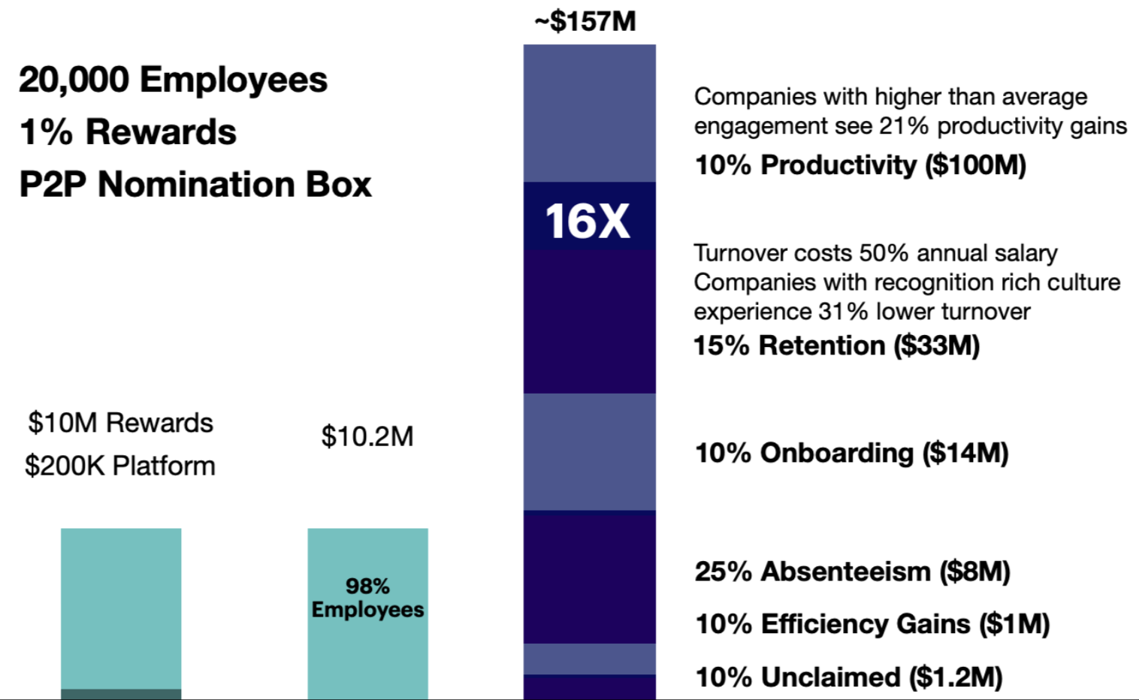
RETURN ON RECOGNITION
Appendix E
1000 Employees
20,000 Employees
10% Onboarding ($30M)
25% Absenteeism ($19M)
10% Efficiency Gains ($2M)
10% Unclaimed ($2M)
Notes:
Productivity
Research shows that companies with higher than average employee engagement levels benefit from 21% higher productivity.
For the purpose of incorporating different scenarios, let’s be conservative and estimate that an effective employee recognition program can lead to 10% higher productivity (i.e. your people could produce just 10% more, saving you from having to hire 10% more people to complete a job).
Total Productivity Gain = # of Employees x Salary x Productivity Increase
Total Productivity Gain = 45,000 x $50,000 x 10%
Total Productivity Gain = $225M
Retention
High employee turnover is one of the largest costs to employers. It includes the cost of re-hiring, training, ramp-up periods, loss of expertise, and higher workloads for other employees while that position is vacant. Voluntary turnover is often due to a disengaged workforce, and in search of jobs that offer better pay, more challenging work, and with a better culture of recognition.
The Bureau of Labor Statistics reports an average turnover rate of 44% annually in the US, as well as an average turnover costs at 38% of the annual salary. This includes hiring, training, ramp-up, loss of expertise during time, higher workloads for other employees while position is vacant.
Besin by Deloitte research found that companies that scored in the top 20% for building a “recognition-rich culture” had 31% lower turnover rates.
Turnover Savings = (45,000 x 44%) x ($50,000 x 38%) x 31%
Turnover Savings @ 31% = $116,622,000
Turnover Savings @ 15% = $58,311,000
On-boarding new hires is a time consuming and expensive process. According to a survey by Korn Ferry, 74% of executives believe that on-boarding is a key factor in retaining new hires. The survey also showed that 67% of the executives believed that including mentors in on-boarding help new hires acclimate better, but half these companies did not have any mentorship programs in place. Having a mentor during on-boarding saves training time as well as improves new hire transition - this depends on commitments from older, highly engaged employees to create a welcoming environment.
On-boarding cost is the cost of lost productivity in a 60 working day on-boarding period, out of a 240 working day year. We estimate an engaged workforce can speed up on-boarding by 10%.
The number of on-boarded employees include new employees through business growth (assumed to be 10% here) as well as from turnover (at 44%).
On-boarding Savings = On-boarding Cost x Savings % x # of On-Boarded Employees
On-boarding Savings = (Training Period x Salary) Savings % x # Employees x (Growth + Turnover)
On-boarding Savings = (60/240 x $50,000) x 10% x 24,300 (10% Growth + 44% Turnover)
On-boarding Savings = $30,375M+
Absenteeism
Companies who move engagement scores from below average to above average can see a 50% reduction in absenteeism
Studies show that on average employees are absent 8 days per year. A 25% reduction would be 2 days per year, per employee.
$50,000/240 working days = $208/day
2 days x 2 = $416
$416 x 45,000 = $18.75M
Efficiency Gains
On average, you need to hire 1-2ppl for every thousand employees, to properly manage a recognition program in-house. Brookdale would need to hire 45-90 people.
45 x $50,000 = $2,250,000
Unclaimed
10% of $22M in rewards is $2.2M

Slide 18
RETURN ON RECOGNITION
Appendix E
45,000 Employees
10% Onboarding ($30M)
25% Absenteeism ($19M)
10% Efficiency Gains ($2M)
10% Unclaimed ($2M)
Notes:
Productivity
Research shows that companies with higher than average employee engagement levels benefit from 21% higher productivity.
For the purpose of incorporating different scenarios, let’s be conservative and estimate that an effective employee recognition program can lead to 10% higher productivity (i.e. your people could produce just 10% more, saving you from having to hire 10% more people to complete a job).
Total Productivity Gain = # of Employees x Salary x Productivity Increase
Total Productivity Gain = 45,000 x $50,000 x 10%
Total Productivity Gain = $225M
Retention
High employee turnover is one of the largest costs to employers. It includes the cost of re-hiring, training, ramp-up periods, loss of expertise, and higher workloads for other employees while that position is vacant. Voluntary turnover is often due to a disengaged workforce, and in search of jobs that offer better pay, more challenging work, and with a better culture of recognition.
The Bureau of Labor Statistics reports an average turnover rate of 44% annually in the US, as well as an average turnover costs at 38% of the annual salary. This includes hiring, training, ramp-up, loss of expertise during time, higher workloads for other employees while position is vacant.
Besin by Deloitte research found that companies that scored in the top 20% for building a “recognition-rich culture” had 31% lower turnover rates.
Turnover Savings = (45,000 x 44%) x ($50,000 x 38%) x 31%
Turnover Savings @ 31% = $116,622,000
Turnover Savings @ 15% = $58,311,000
On-boarding new hires is a time consuming and expensive process. According to a survey by Korn Ferry, 74% of executives believe that on-boarding is a key factor in retaining new hires. The survey also showed that 67% of the executives believed that including mentors in on-boarding help new hires acclimate better, but half these companies did not have any mentorship programs in place. Having a mentor during on-boarding saves training time as well as improves new hire transition - this depends on commitments from older, highly engaged employees to create a welcoming environment.
On-boarding cost is the cost of lost productivity in a 60 working day on-boarding period, out of a 240 working day year. We estimate an engaged workforce can speed up on-boarding by 10%.
The number of on-boarded employees include new employees through business growth (assumed to be 10% here) as well as from turnover (at 44%).
On-boarding Savings = On-boarding Cost x Savings % x # of On-Boarded Employees
On-boarding Savings = (Training Period x Salary) Savings % x # Employees x (Growth + Turnover)
On-boarding Savings = (60/240 x $50,000) x 10% x 24,300 (10% Growth + 44% Turnover)
On-boarding Savings = $30,375M+
Absenteeism
Companies who move engagement scores from below average to above average can see a 50% reduction in absenteeism
Studies show that on average employees are absent 8 days per year. A 25% reduction would be 2 days per year, per employee.
$50,000/240 working days = $208/day
2 days x 2 = $416
$416 x 45,000 = $18.75M
Efficiency Gains
On average, you need to hire 1-2ppl for every thousand employees, to properly manage a recognition program in-house. Brookdale would need to hire 45-90 people.
45 x $50,000 = $2,250,000
Unclaimed
10% of $22M in rewards is $2.2M

Slide 19
RETURN ON RECOGNITION
Appendix E
Productivity
Research shows that companies with higher than average employee engagement levels benefit from 21% higher productivity.
For the purpose of incorporating different scenarios, let’s be conservative and estimate that an effective employee recognition program can lead to 10% higher productivity (i.e. your people could produce just 10% more, saving you from having to hire 10% more people to complete a job).
Total Productivity Gain = # of Employees x Salary x Productivity Increase
Total Productivity Gain = 45,000 x $50,000 x 10%
Total Productivity Gain = $225M
10% Onboarding ($30M)
25% Absenteeism ($19M)
10% Efficiency Gains ($2M)
10% Unclaimed ($2M)

Slide 20
RETURN ON RECOGNITION
Appendix E
Retention
High employee turnover is one of the largest costs to employers. It includes the cost of re-hiring, training, ramp-up periods, loss of expertise, and higher workloads for other employees while that position is vacant. Voluntary turnover is often due to a disengaged workforce, and in search of jobs that offer better pay, more challenging work, and with a better culture of recognition.
The Bureau of Labor Statistics reports an average turnover rate of 44% annually in the US, as well as an average turnover costs at 38% of the annual salary. This includes hiring, training, ramp-up, loss of expertise during time, higher workloads for other employees while position is vacant.
Besin by Deloitte research found that companies that scored in the top 20% for building a “recognition-rich culture” had 31% lower turnover rates.
Turnover Savings = (45,000 x 44%) x ($50,000 x 38%) x 31%
Turnover Savings @ 31% = $116,622,000
Turnover Savings @ 15% = $58,311,000
10% Onboarding ($30M)
25% Absenteeism ($19M)
10% Efficiency Gains ($2M)
10% Unclaimed ($2M)

Slide 21
RETURN ON RECOGNITION
Appendix E
Onboarding new hires is a time consuming and expensive process. According to a survey by Korn Ferry, 74% of executives believe that onboarding is a key factor in retaining new hires. The survey also showed that 67% of the executives believed that including mentors in onboarding help new hires acclimate better, but half these companies did not have any mentorship programs in place. Having a mentor during onboarding saves training time as well as improves new hire transition - this depends on commitments from older, highly engaged employees to create a welcoming environment.
Onboarding cost is the cost of lost productivity in a 60 working day onboarding period, out of a 240 working day year. We estimate an engaged workforce can speed up on-boarding by 10%.
The number of onboarded employees include new employees through business growth (assumed to be 10% here) as well as from turnover (at 44%).
Onboarding Savings = Onboarding Cost x Savings % x # of Onboarded Employees
Onboarding Savings = (Training Period x Salary) Savings % x # Employees x (Growth + Turnover)
Onboarding Savings = (60/240 x $50,000) x 10% x 24,300 (10% Growth + 44% Turnover)
Onboarding Savings = $30,375M+
10% Onboarding ($30M)
25% Absenteeism ($19M)
10% Efficiency Gains ($2M)
10% Unclaimed ($2M)

Slide 22
RETURN ON RECOGNITION
Appendix E
Absenteeism
Companies who move engagement scores from below average to above average can see a 50% reduction in absenteeism
Studies show that on average employees are absent 8 days per year. A 25% reduction would be 2 days per year, per employee.
$50,000/240 working days = $208/day
2 days x 2 = $416
$416 x 45,000 = $18.75M
10% Onboarding ($30M)
25% Absenteeism ($19M)
10% Efficiency Gains ($2M)
10% Unclaimed ($2M)

Slide 23
RETURN ON RECOGNITION
Appendix E
Efficiency Gains
On average, you need to hire 1-2ppl for every thousand employees, to properly manage a recognition program in-house. A company with 45,000 employees would need to hire 45-90 people.
45 x $50,000 = $2,250,000
10% Onboarding ($30M)
25% Absenteeism ($19M)
10% Efficiency Gains ($2M)
10% Unclaimed ($2M)

Slide 24
RETURN ON RECOGNITION
Appendix E
10% Onboarding ($30M)
Unclaimed
10% of $22M in rewards is $2.2M
25% Absenteeism ($19M)
10% Efficiency Gains ($2M)
10% Unclaimed ($2M)

